Slide 1
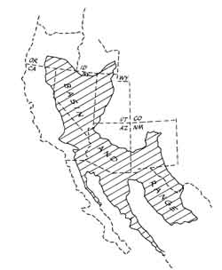
Grand Tetons
Part 2
Notes:
Now let’s see how the Tetons’ were affected by glaciation. Remember that there are two important consequences of their position at the far northeasterly tip of the Basin and Range. We just covered the first of these, which was that youthful extension yields highly asymmetrical basins bounded by steep fault scarps on one side. In this lesson we’ll focus on the second consequence of the Tetons’ location, which is that this northerly position made the Tetons susceptible to glaciation.

Slide 2
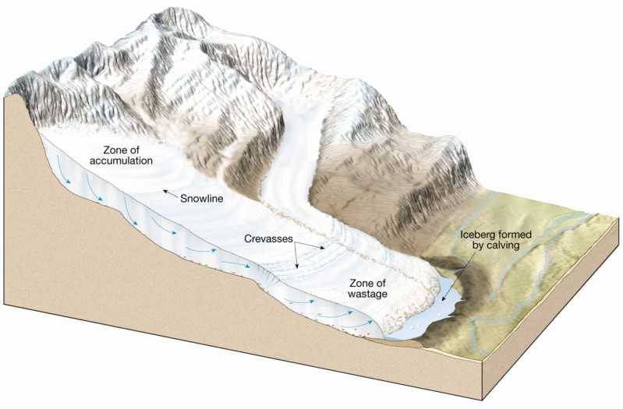
Glaciers
Notes:
Glaciers are large masses of ice which form on land by the compaction and recrystallization of snow. They form where more snow falls in the winter than melts in the summer, which tends to be in high latitudes and high altitudes. They slide and flow downhill, carving-out spectacular U-shaped canyons and generating mass quantities of sediment in the process.

Slide 3
Stages of Glaciation in the Tetons
Buffalo - 200,000 years ago
Bull Lake - 35,000-80,000 years ago
Pinedale - 9,000 years ago*
“Little Ice Age” – 300-400 years ago
Notes:
The glacial landforms in the Tetons were created by a series of relatively recent glacial periods. By far the most important is the Pinedale stage about 9000 years ago.

Slide 4
Causes of Glacial Ages
1. Plate Tectonics controls:
paleogeography
volcanism ==> atmospheric content
Notes:
Glacial ages are caused by a variety of factors including plate tectonics, which controls both paleogeography and volcanic activity, which in turn influences atmospheric content.

Slide 5
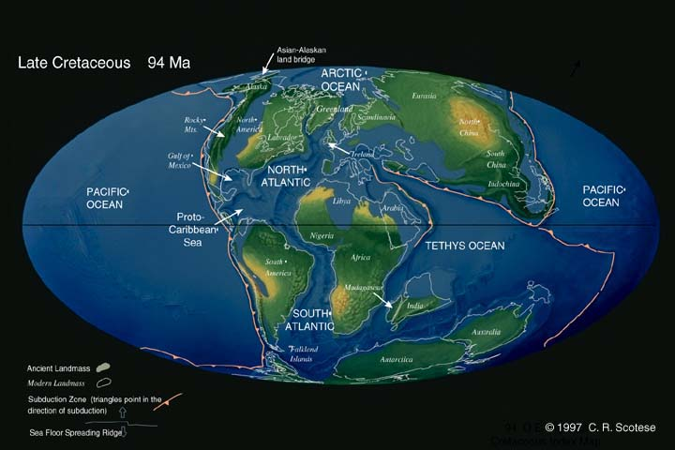
Notes:
For example, the rapid sea floor spreading during the Cretaceous led to unusually vigorous volcanism which released huge amounts of carbon dioxide.

Slide 6
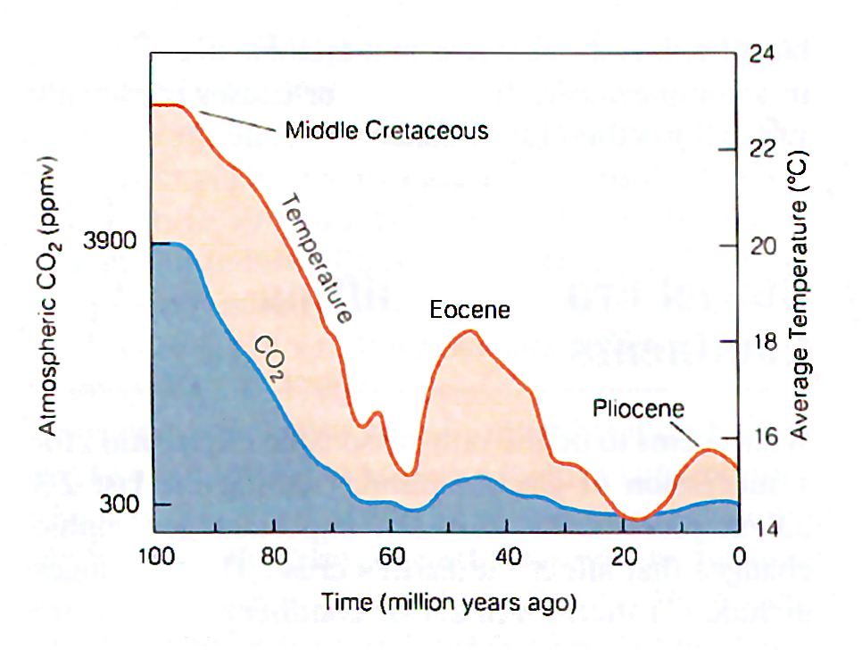
Notes:
Cretaceous CO2 levels where 10 times higher than today, causing an intense greenhouse effect that made average global temperatures 5 degrees Celsius higher than today.

Slide 7
Stages of Glaciation in the Tetons
Buffalo - 200,000 years ago
Bull Lake - 35,000-80,000 years ago
Pinedale - 9,000 years ago*
“Little Ice Age” – 300-400 years ago
Notes:
Plate tectonic controls explain why glaciation periods occurred within the last million years or so, but they are far too slow to cause the short term variations within that period.

Slide 8
Causes of Glacial Ages
1. Plate Tectonics controls:
paleogeography
volcanism / atmospheric content
2. Milankovitch Cycles
Notes:
Superimposed on the plate tectonic controls are Milankovitch Cycles.

Slide 9
Milankovitch Cycles
Notes:
These involve periodic variations in the shape of the earth’s orbit and the amount and direction of tilt on the earth’s axis.

Slide 10
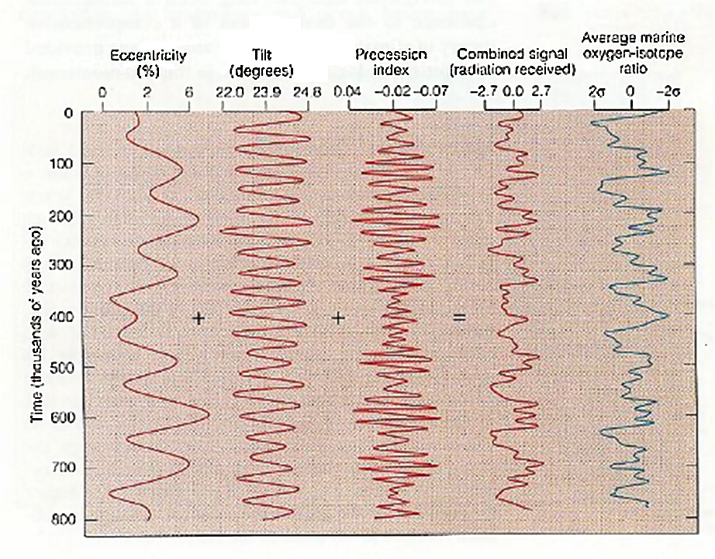
Notes:
When the various Milankovitch cycles are combined, they produce a pattern similar to that of marine oxygen-isotope ratios which are linked to global temperature. These variations in temperature have periodicities that match nicely…

Slide 11
Stages of Glaciation in the Tetons
Buffalo - 200,000 years ago
Bull Lake - 35,000-80,000 years ago
Pinedale - 9,000 years ago*
“Little Ice Age” – 300-400 years ago
Notes:
… with those seen for the various glacial stages of the Pleistocene and Holocene epochs.

Slide 12
Types of glaciers:
Continental ice sheets
Alpine glaciers
Piedmont glaciers
Notes:
Three types of glaciers are recognized, depending on where the glaciers form. Continental ice sheets cover continental sized areas like Antarctica and Greenland. Such glaciers did not shape Grand Tetons National Park, but Alpine and Piedmont glaciers did.

Slide 13
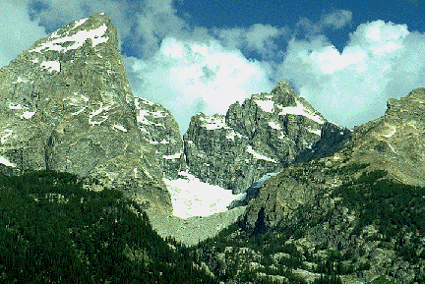
Teton Glacier (alpine)
Notes:
Teton Glacier is an example of the alpine type, which are confined to valleys in mountainous areas.

Slide 14
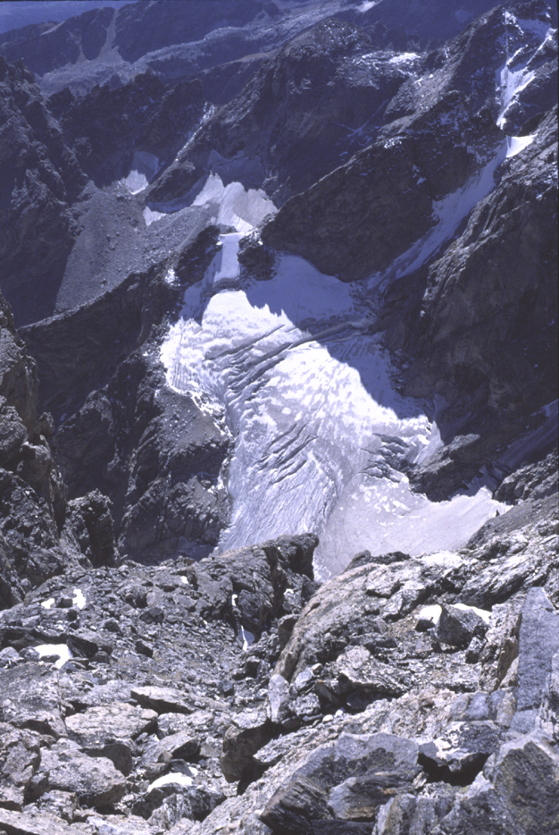
Notes:
Middle Teton Glacier is also alpine…

Slide 15
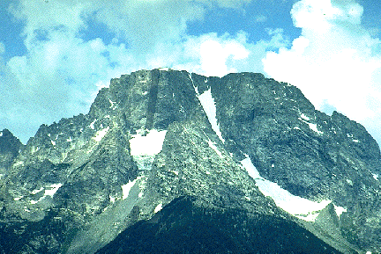
Notes:
… and so is Mt Moran Glacier. Since we are currently in an interglacial period these glaciers are relatively small, …

Slide 16
Stages of Glaciation in the Tetons
Buffalo - 200,000 years ago
Bull Lake - 35,000-80,000 years ago
Pinedale - 9,000 years ago*
“Little Ice Age” – 300-400 years ago
Notes:
… but during the various glacial stages much larger glaciers occupied the mountain valleys.

Slide 17
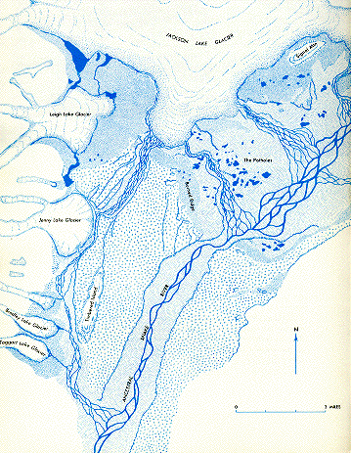
Alpine
Piedmont
Notes:
This map shows the inferred position of Grand Teton glaciers during the Pinedale stage about 9000 years ago. When alpine glaciers leave the confines of their mountain valleys and extend onto the open basin they are called piedmont glaciers. Note the large piedmont glacier that covered the area now occupied by Jackson Lake.

Slide 18
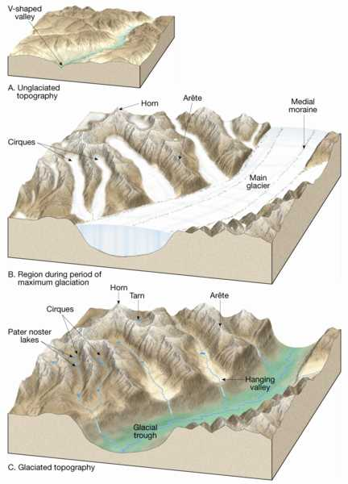
Notes:
Unlike rivers, that can only erode the bottom of a canyon, glaciers, which can completely fill a canyon, erode the sides of the canyon as well as the bottom. The result is that glacially eroded troughs are typically U-shaped in cross section.

Slide 19
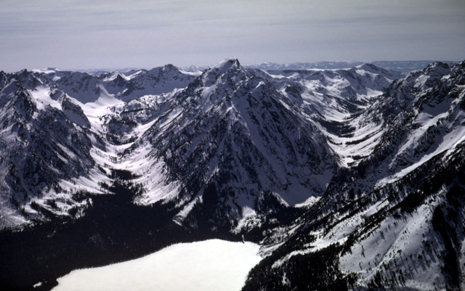
Paintbrush Canyon
Leigh Canyon
U-Shaped cross sections
Notes:
That U-shape is clearly seen in Paintbrush and Leigh Canyons.

Slide 20
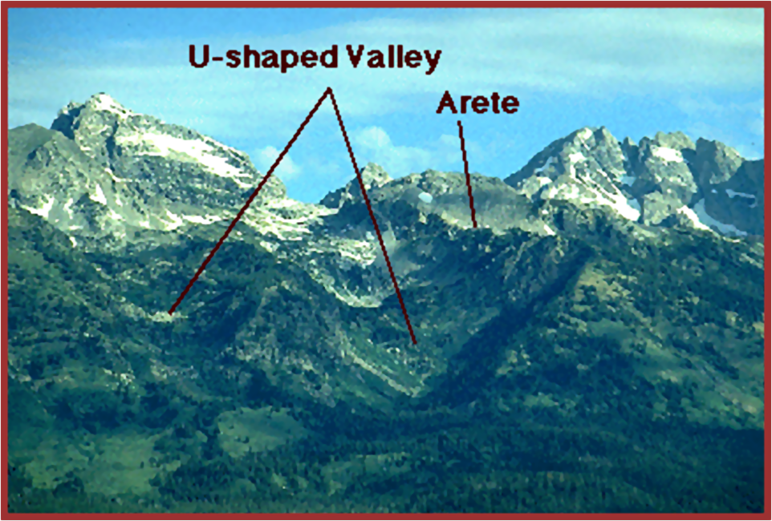
Notes:
Glacial erosion in adjacent valleys will eventually sharpen the intervening ridge into a narrow ridge of bare rock called an arête.

Slide 21
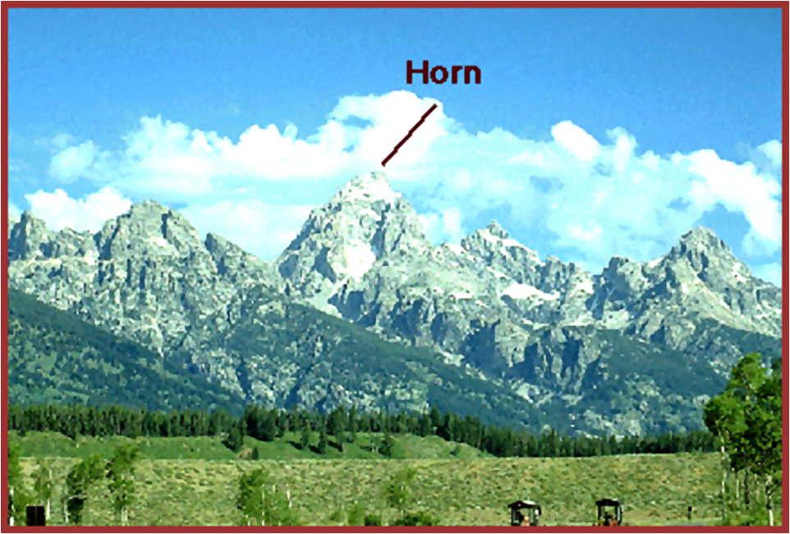
Notes:
Where arêtes join, the result is a pyramidal mountain called a horn.

Slide 22
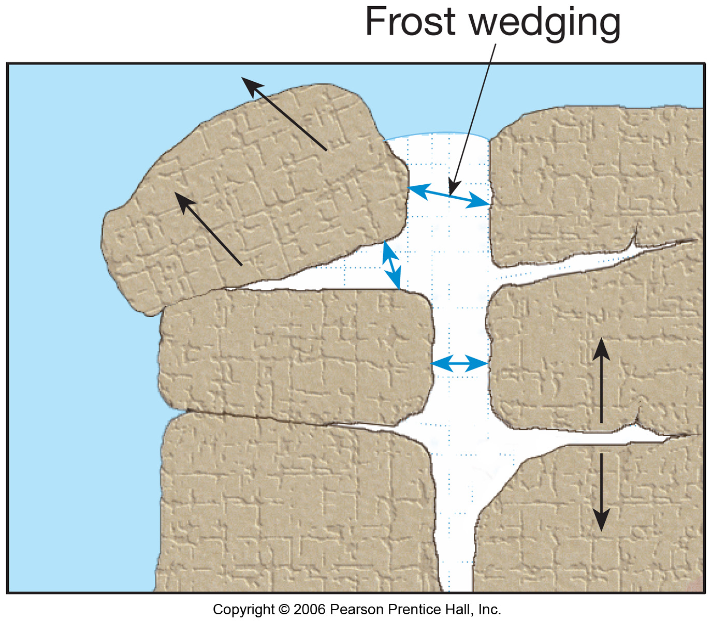
Notes:
In addition to the large scale glacial erosion, horns and arêtes are more finely sculpted by the expansion of ice in rock fractures – a process called frost wedging. Eventually blocks of rock are pried loose and tumble to the base of the slope.

Slide 23
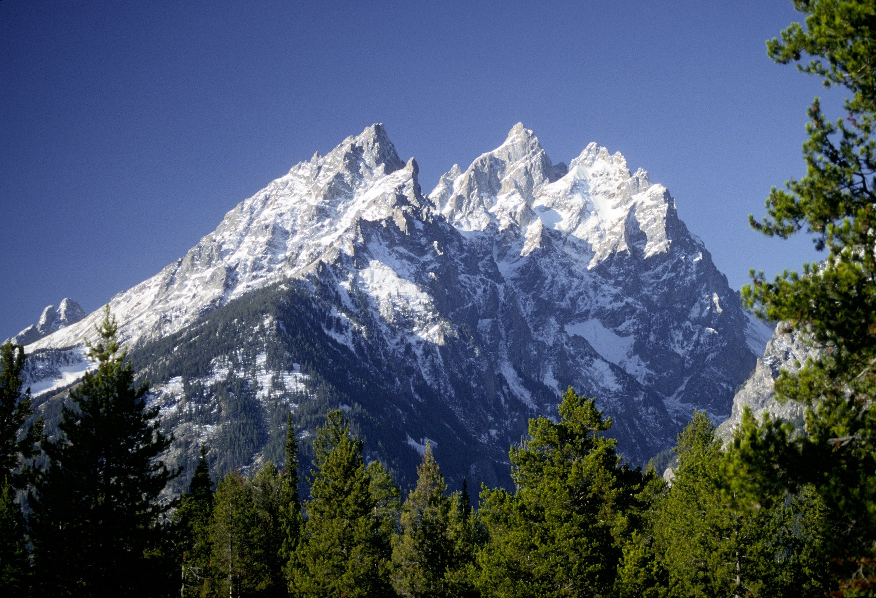
The Cathedral Group
Notes:
The result is that frost wedging makes for the exceptionally angular topography seen on most of the peaks in the Grand Tetons.

Slide 24
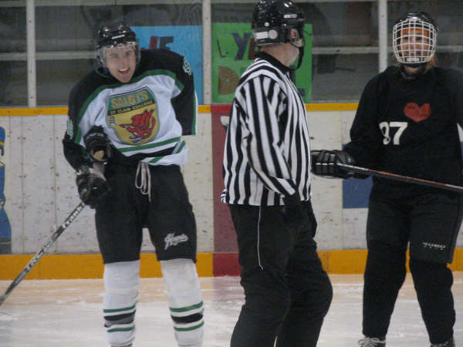
Notes:
Frost wedgies on the other hand, will give you 5 minutes in the penalty box.

Slide 25
Glacial Depositional Features:
Till
poorly sorted
clay rich
high water table = Lodgepole pine
Outwash
well sorted
quartz sand
low water table = sagebrush
Notes:
Now let’s take a look at what happens to all the glacially eroded debris. Eventually it’s deposited as either till or outwash. Till is deposited directly from the motion of the ice. Think of till as being like the pile of debris pushed out in front of a bulldozer, but the glacier is the dozer. Till will therefore be a poorly sorted mixture of grain sizes including everything from giant boulders to finely ground rock flour that weathers quickly to clay. Due to the high clay content, water slowly seeps through till, keeping the water table high enough for Lodgepole pines to grow. On the other hand, outwash is carried by glacial melt water, in which sediments become far-better sorted quartz sands. Percolation is much better, so the water table lowers to the point that only sagebrush can grow.

Slide 26
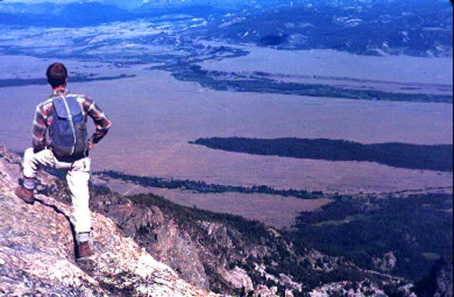
Outwash plain
Moraine (made of till)
Notes:
Till typically forms pile-like masses called moraines whereas the action of water spreads outwash into plains. Outwash plains and moraines are easily distinguished from one another on the basis of vegetation. Evergreen forests grow on the till of the moraines because the unsorted sediment is less permeable and can support a relatively high water table. Outwash is very permeable and has a lower water table.

Slide 27
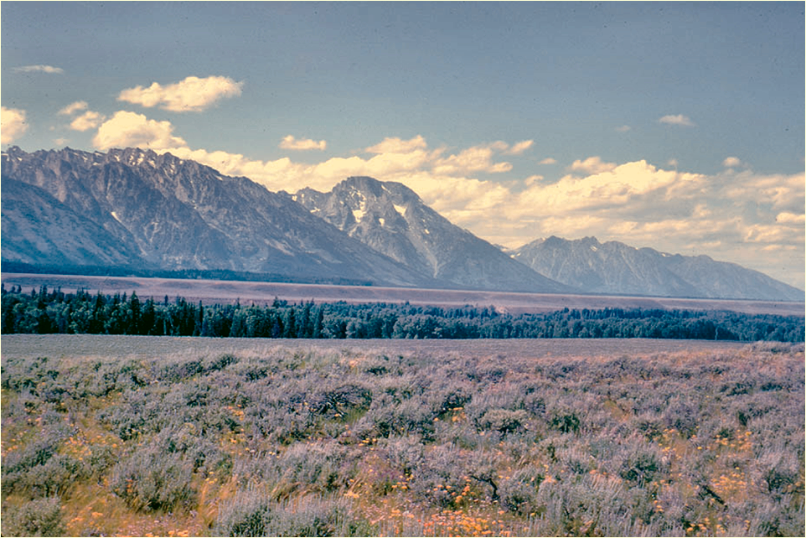
Till or outwash?
Notes:
Is the foreground here till or outwash?... The sagebrush tells you it’s outwash. The evergreens in the mid-ground are growing near the Snake River…

Slide 28
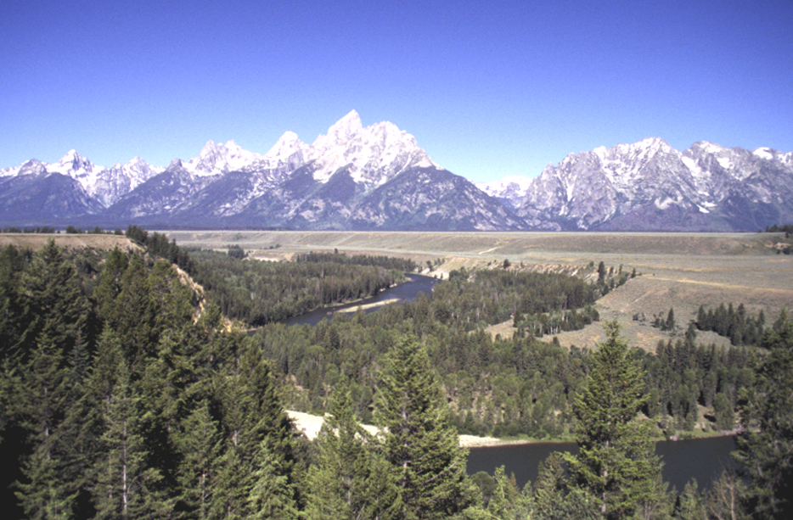
Notes:
… where the water table is closer to the surface.

Slide 29
terrace
Notes:
This photo also shows the Snake River terrace, which is a remnant of an older flood plain of the Snake River.

Slide 30
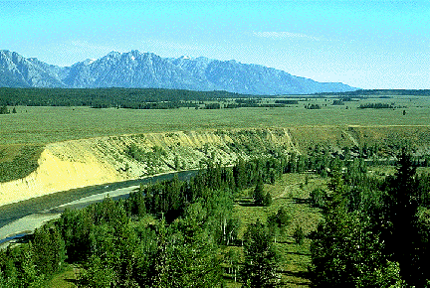
Notes:
You can clearly see the sandy outwash on the river’s cut banks.

Slide 31
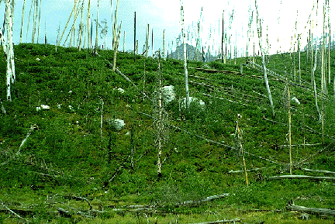
Till or outwash?
Notes:
…. Obviously till right? You can tell by the mound-like topography, trees, and boulders.

Slide 32
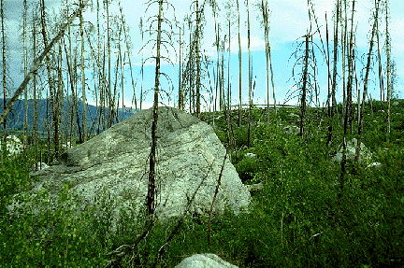
Glacial erratic
Notes:
Unusually large particles in till are called glacial erratics. They are typically angular, because they were transported by ice, not running water.

Slide 33
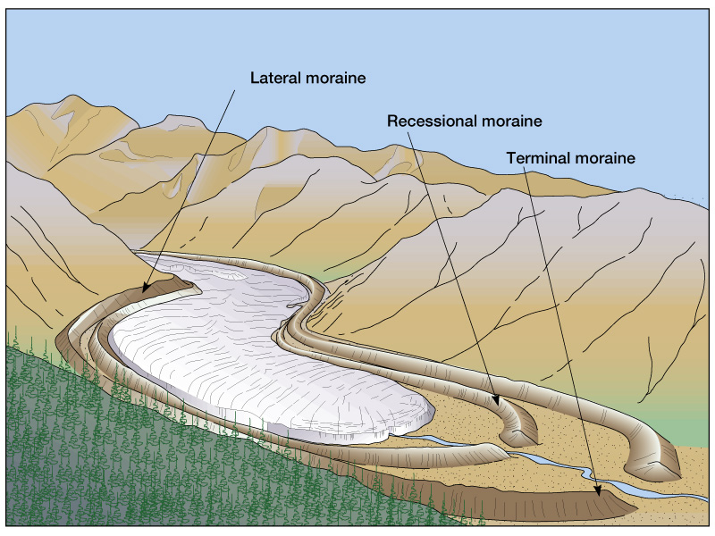
Notes:
Till is pushed to the sides and ends of the glacier forming lateral and terminal moraines respectively. Recessional moraines are formed as the glacier melts back.

Slide 34
Notes:
You can understand the difference between the formation of terminal and recessional moraines by visualizing a glacier as a giant belt sander. Terminal moraines mark the furthest extent of the glaciers, but like a belt sander, even when a glacier is neither advancing nor retreating, it is still grinding away, producing debris. Recessional moraines form when periods of equilibrium are established between ice accumulation and melting.

Slide 35
Notes:
The mound-like structure of moraines often dams glacial melt water and creates lakes.

Slide 36
Lakes
Piedmont glacier recessional moraine
Jackson Lake
Terminal moraine dammed lakes
Jenny lake
Bradley Lake
Taggart Lake
Kettle holes
The Potholes
Christian Pond
Notes:
Most of the major lakes in Grand Tetons National Park are moraine dammed.

Slide 37
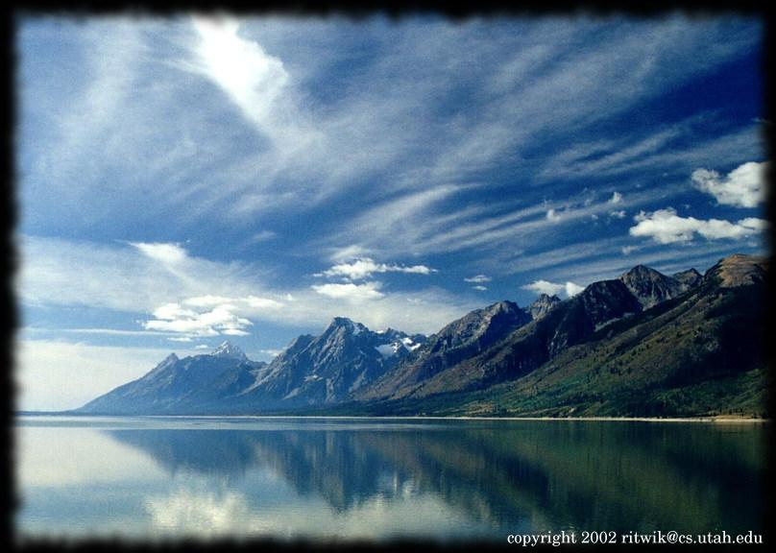
Notes:
That includes the largest lake of the all - Jackson Lake, …

Slide 38
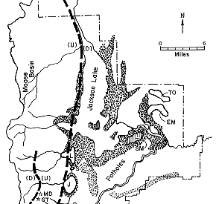
Recessional moraine
Notes:
… which formed behind the recessional moraine of a Pinedale stage piedmont glacier.

Slide 39
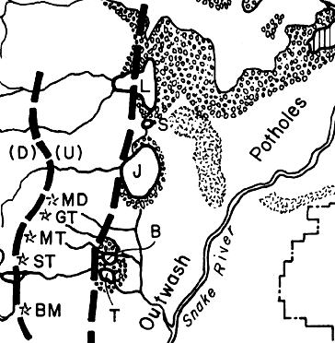
Notes:
South of Jackson Lake there are several terminal moraine damned lakes at the base of the Tetons.

Slide 40
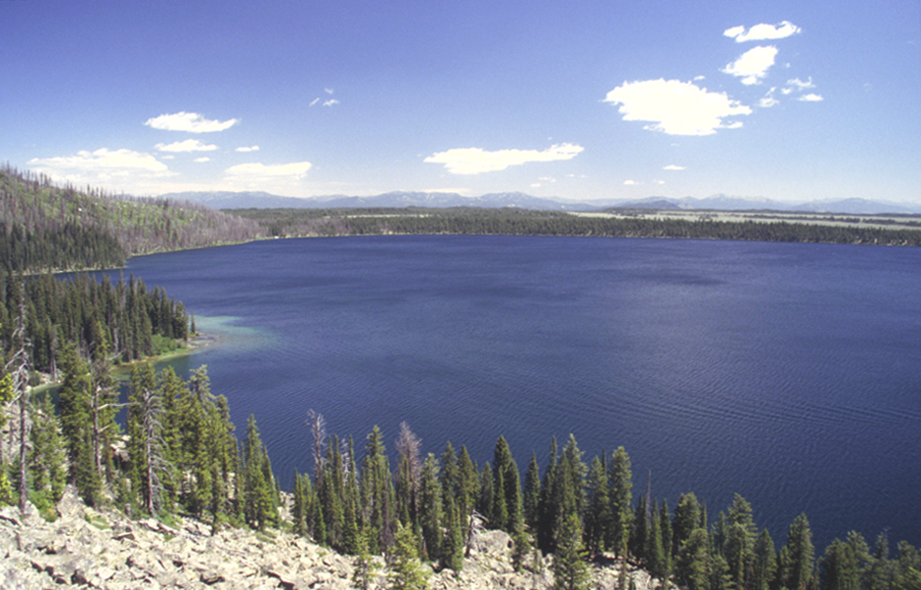
Terminal moraine
Notes:
Jenny Lake is the largest of these. Notice the terminal moraine in the background.

Slide 41
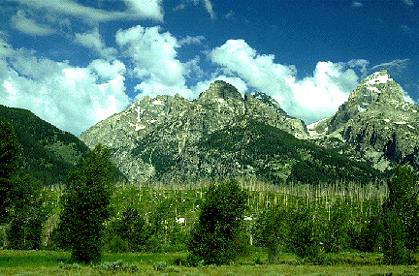
Taggart Lake Terminal moraine
Notes:
The terminal moraine which dams Taggart Lake is especially well developed.

Slide 42
Notes:
Finally, there are dozens of tiny lakes in the outwash plain, collectively known as “The Potholes”.

Slide 43
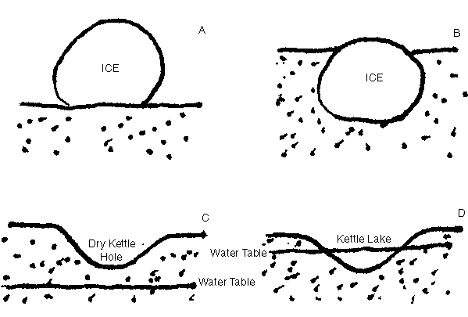
Lakes
Piedmont glacier recessional moraine
Jackson Lake
Terminal moraine dammed lakes
Jenny lake
Bradley Lake
Taggart Lake
Kettle holes
The Potholes
Christian Pond
Notes:
Geologically these are a type of lake know as kettle holes or kettle lakes. They form when outwash buries a block of ice that has separated from the main glacier. The melting of the ice leaves a hole which fills with water if the water table is high enough.

Slide 44
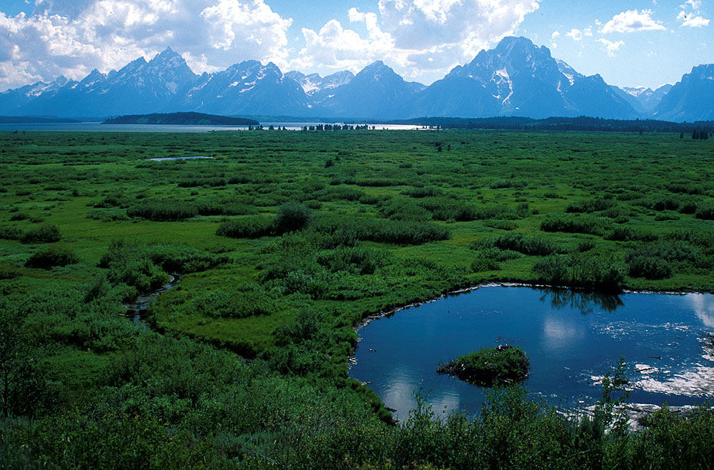
Notes:
Although too small and ephemeral to offer much recreational value, the tiny Potholes nonetheless add a pleasing aesthetic counterpoint to the grandeur of the Tetons.

Slide 45
Check out
Google Earth
(grandtetons.kmz)
Notes:
That concludes this lesson, but be sure to check out the Google Earth tour of the Tetons. You’ll find both a narrated video of the tour and the actual Google Earth .kmz file of the tour in the same folder as this video. If you are not completely proficient at using Google Earth, then I highly recommend that you check out the video first, because it covers the basics of using Google Earth. I think you’ll find that Google Earth adds a fascinating dimension to your understanding and appreciation of the geology of our National Parks.

Slide 46
Fin

Slide 47
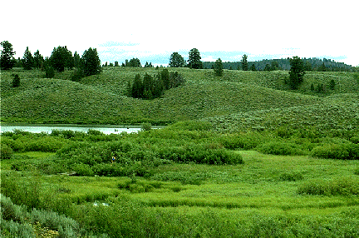
Notes:
Christian Pond – a pothole lake

Slide 48
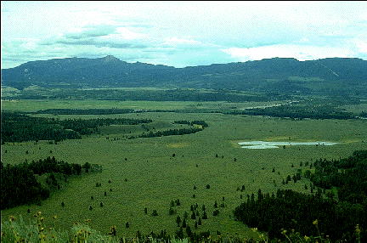
Notes:
Jackson Hole outwash plain

Slide 49
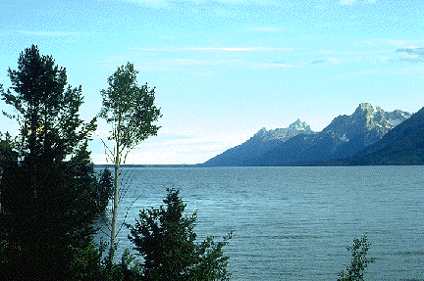
Notes:
Jackson lake

Slide 50
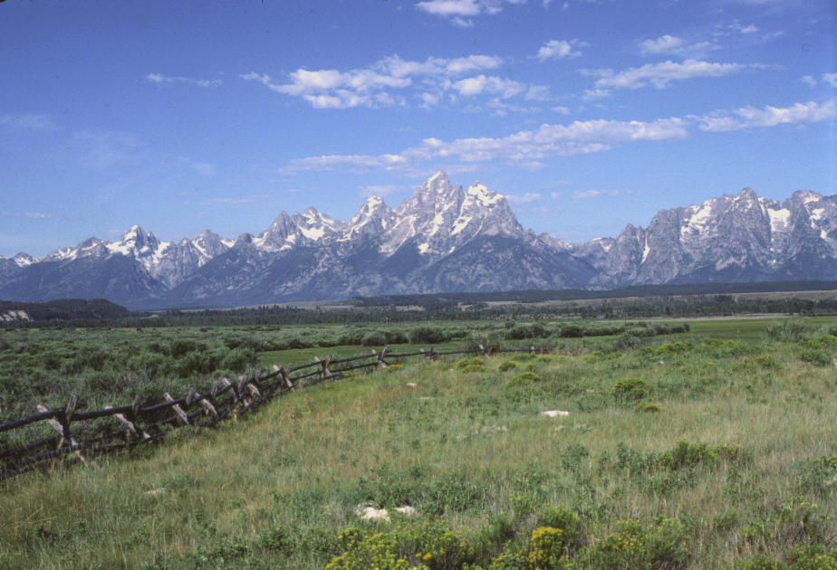
Notes:
Teton Range. (Photo by David B. Hacker)

Slide 51
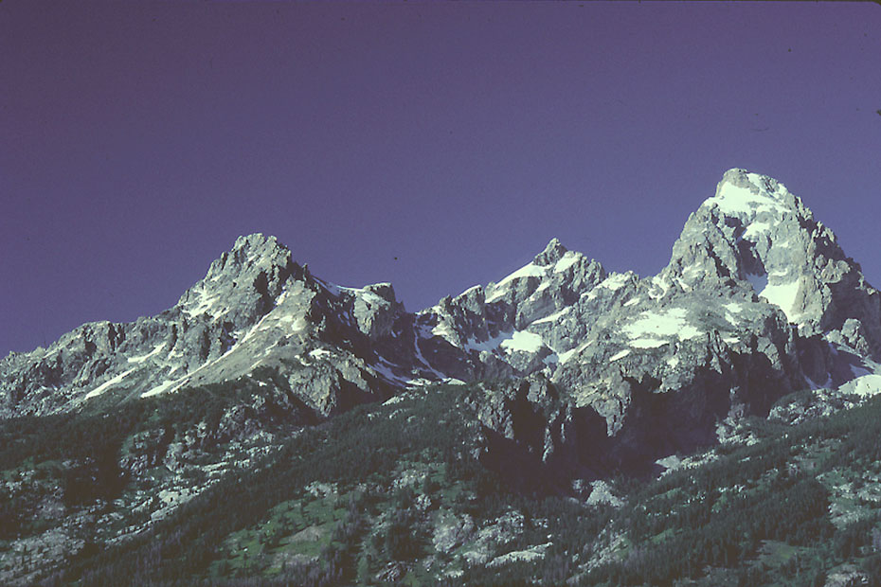
Notes:
View to Grand Teton. (Photo by Ronald F. Hacker)

Slide 52
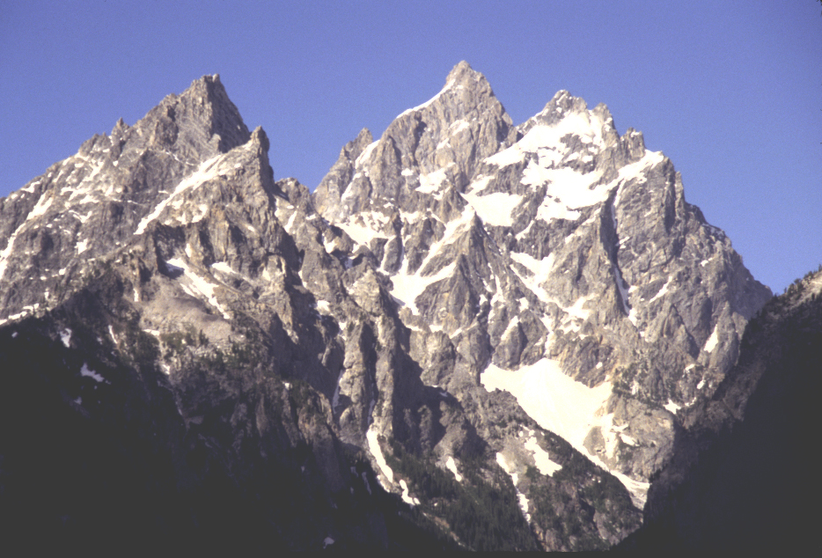
Ice wedgies are the worst!
Notes:
Frost wedgies make for angular topography

Slide 53
